Slide 1





وزارة الاتصالات وتكنولوجيا المعلومات تحت اشراف شركة CLS د. ماجد مجدي

Slide 2


Super Store Sales Dashboard

Slide 3
Team Members and Tasks assigned
Esraa Mohamed
Abdel Rahman
Ahmed Rashed
Islam Hamdy
Extract & document the raw sales data
Clean & prep the dataset (remove blanks, fix formats)
Sketch the dashboard layout (which charts, where)
Translate findings into 3–5 clear recommendations
Prepare the final slide/report narrative
Identify key fields (date, product, customer, amount)
Define visuals (e.g. bar for sales by month, line for trends)
Create Measures and Relations

Slide 4

Data Overview
The Superstore Sales dataset comprises 9,800 transactions recorded from Jan 2015, through Jan 2019.
It brings together order details (order and ship dates, ship mode), customer profiles (ID, name, segment), product hierarchies (category, sub-category) and geographic attributes (city, state, region), all tied to transaction-level sales figures.
This rich, multi-dimensional dataset provides a solid foundation for uncovering seasonal trends, regional performance variations and segment-specific insights, and supports the creation of an interactive Power BI dashboard to drive actionable, data-driven recommendations.

Slide 5
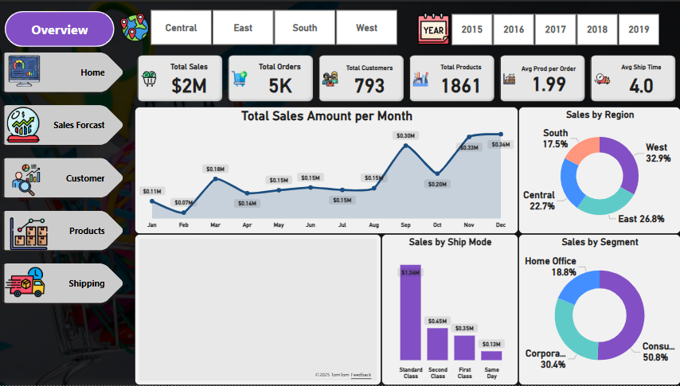

Slide 6
Overview Insights
$2 M in Total Sales across 5,000 orders for 793 customers, averaging just under 2 products per order.
Seasonal Trend: Sales dipped to ~$0.07 M in February, stabilized around $0.15 M most of the year, then surged to $0.34 M in December.
Regional Leadership: West region accounts for 32.9% of revenue, followed by East (26.8%), Central (22.7%) and South (17.5%).
Customer Segments: Consumers drive 50.8% of sales, Corporates 30.4%, Home Office 18.8%.
Shipping Modes: Standard Class dominates with $1.34 M (67% of sales), while faster options (Second, First, Same Day) make up the remainder.
Logistics Performance: Average delivery time is 4 days—an opportunity to enhance customer satisfaction and competitive advantage.

Slide 7
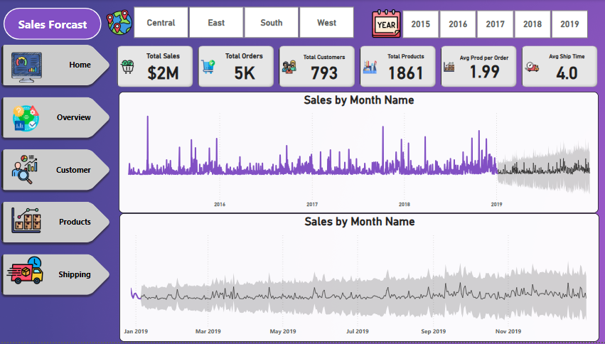

Slide 8
Sales Forecast Insights
Key Insights:
Sales Trends Overview (2015-2019): Sales remained relatively stable between 2015 and 2018, with noticeable seasonal spikes.
A clear upward sales trend started in 2019, showing steady and consistent growth.
Seasonal peaks align with major promotional periods (e.g., Black Friday, year-end sales).
2019 sales are significantly stronger and more stable compared to previous years.
Forecast projections indicate continued positive momentum with minimal volatility.

Slide 9
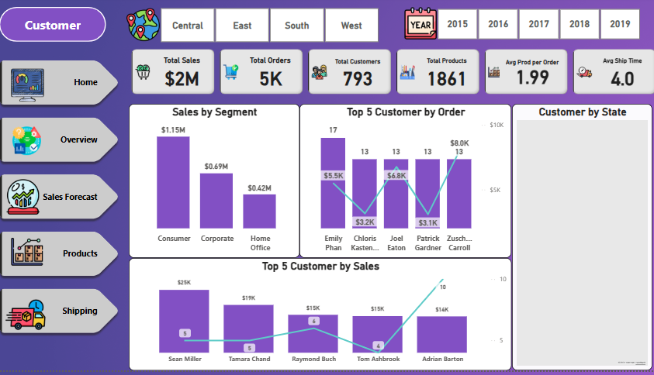

Slide 10
Customer Insights
Key Insights:
Total Sales reached $5K across 20 orders with a customer base of 793.
Consumer segment dominates sales with $3.6K, followed by Corporate ($1.2K) and Home Office ($0.3K).
Emily Phan leads in order volume with 17 orders, while several others follow closely with 13 orders.
Katherine Hughes is the top customer by sales, contributing $1,814.68 alone.
No new customers were added; customer base remains the same as the previous year.
Geographically, customer concentration is highest in the eastern and western United States.

Slide 11
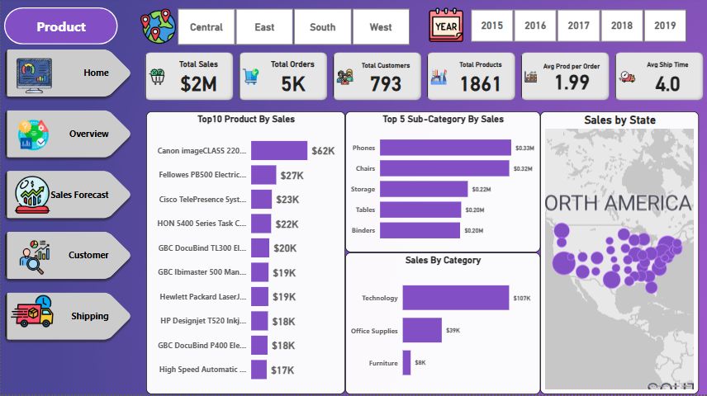

Slide 12
Products Insights
Key Insights:
Total Sales achieved $2M across 5K orders, serving 793 customers with 1,861 products offered.
The average products per order is 1.99, and the average shipping time is 4 days.
Top-selling product is the Canon image
CLASS 2200 generating $62K in sales.
Phones lead the Top 5 Sub-Categories by sales with $334K, followed by Chairs and Storage.
Technology dominates Sales by Category with $107K, far exceeding Office Supplies ($39K) and Furniture ($9K).
Customer distribution remains highly concentrated in North America, with significant clusters on the East and West Coasts.

Slide 13
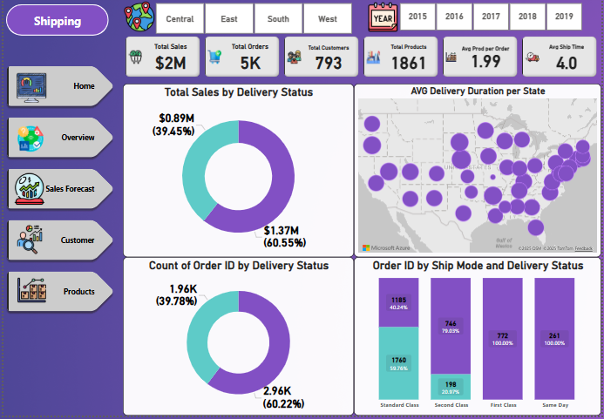

Slide 14
Shipping Insights
Key Insights:
Total Sales reached $2M across 5K orders, serving 793 customers with 1,861 products.
Delivered orders account for 60.55% of total sales ($1.37M) and 60.22% of total orders (2.96K orders).Undelivered orders represent 39.45% of sales ($0.89M) and 39.78% of orders (1.96K orders).Standard Class is the most used shipping method, handling 53.2% of orders, while Same Day deliveries account for 5.2%.The average delivery time across states is around 4 days, with notable variation across regions.

Slide 15

Recommendations
Enhance Seasonal Campaigns
Capitalize on peak seasons like December and Black Friday through intensified marketing campaigns and special promotions.
Invest in High-Performing Regions
Focus investments on the West and East regions, while developing targeted strategies to boost sales in the South and Central regions.
Segmented Customer Targeting
Launch tailored campaigns for each customer segment (Consumer, Corporate, Home Office) based on their unique purchasing behaviors.
Optimize Shipping Efficiency
Improve average delivery time, especially by offering faster shipping options for high-priority orders to increase customer satisfaction.
Expand Technology Product Lines
Given Technology leads in sales, it’s recommended to expand the tech product offerings and reinforce promotional efforts in this category.

Slide 16
Recommendations
Implement Customer Retention Programs
Develop loyalty programs to strengthen relationships with existing customers, particularly as no new customers were added recently.
Enhance Delivery Performance Across Regions
Reduce the overall delivery time below the current 4-day average, especially in underperforming regions, to drive competitive advantage.
Leverage Best-Selling Products
Increase promotions around best-selling products like the Canon image CLASS 2200 and create incentive programs to maximize their sales potential.

